Slide 1
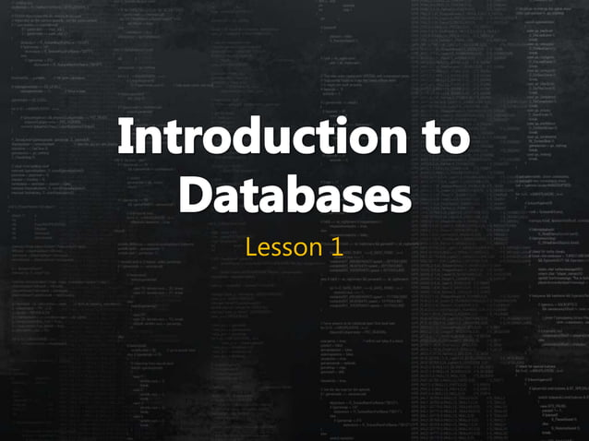
Lecture no 1
20-feb-2024
Ayesha jarral

Slide 2
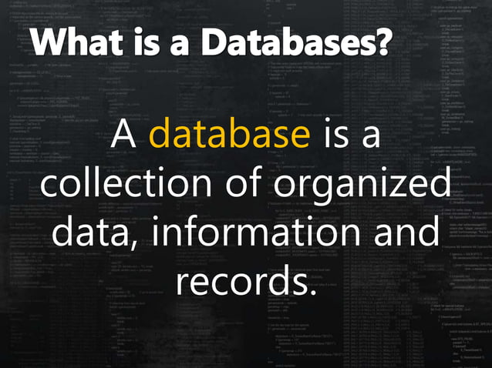
Notes:
Databases are organized collections of data, typically structured to facilitate efficient storage, retrieval, and manipulation of information. They are fundamental in various applications across different industries. Here are some real-life examples of databases:
Customer Relationship Management (CRM) Database: CRM databases store information about customers, including contact details, purchase history, preferences, and interactions. Companies use CRM databases to manage relationships with customers and improve marketing, sales, and support efforts. Salesforce and HubSpot are examples of CRM systems that use databases to organize customer data.
Human Resources Management System (HRMS) Database: HRMS databases store employee information such as personal details, job history, performance evaluations, and payroll data. These databases help organizations manage human resources efficiently. Workday and ADP Workforce Now are examples of HRMS systems that utilize databases to store employee information.
E-commerce Database: E-commerce platforms use databases to store product catalogs, customer orders, payment information, and shipping details. Amazon and Shopify are examples of e-commerce platforms that rely on databases to manage their vast inventory and process transactions.
Inventory Management Database: Inventory management databases track the movement of goods in and out of warehouses or stores. They store information about stock levels, product locations, suppliers, and purchase orders. Retailers, manufacturers, and logistics companies use inventory management databases to optimize inventory levels and streamline operations.
Banking System Database: Banking systems use databases to store customer accounts, transactions, loan details, and financial records. These databases ensure secure and reliable management of banking operations, including online banking, ATM transactions, and loan processing. Core banking systems like FISERV and FIS Global rely on databases to handle financial transactions.
Social Media Database: Social media platforms store vast amounts of user-generated content, including posts, comments, likes, and connections between users. These databases enable social media companies to deliver personalized content, facilitate interactions between users, and analyze user behavior for targeted advertising. Facebook and Twitter are examples of social media platforms powered by databases.
Healthcare Information System Database: Healthcare databases store patient records, medical histories, test results, prescriptions, and billing information. Electronic Health Record (EHR) systems use databases to centralize patient data, streamline clinical workflows, and improve patient care coordination. Epic Systems and Cerner Corporation provide EHR solutions that rely on databases to manage healthcare information.

Slide 3
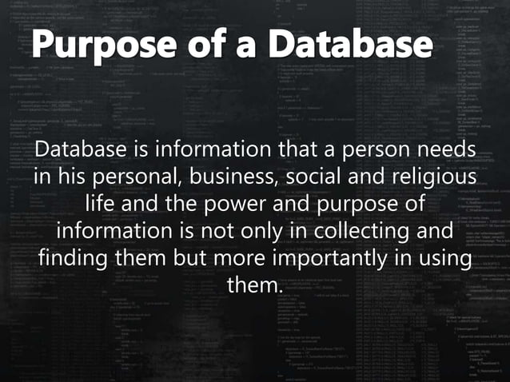
Notes:
The purpose of a database is to efficiently store and manage large amounts of data, making it easy to access and manipulate information as needed. Let's explore this with a simple example:
Imagine you have a collection of recipe cards. Each card contains a recipe, including ingredients and instructions. Without a database, you might store these cards in a box, making it challenging to find specific recipes or update them easily.
Now, consider using a recipe database. In this database:
Organization: Each recipe is a record in the database. You can categorize recipes by type (e.g., appetizers, main courses, desserts) and assign tags (e.g., vegetarian, gluten-free) for easy sorting and filtering.
Storage: Instead of physical cards, the recipes are stored digitally in the database. This saves physical space and allows for easy access from anywhere with an internet connection.
Retrieval: When you want to find a recipe, you can simply search the database by keywords, ingredients, or categories. The database quickly retrieves the relevant recipes, making it much faster than manually searching through a box of cards.
Updates: If you want to modify a recipe or add a new one, you can easily do so in the database. Changes are instantly reflected, ensuring that your recipe collection stays up-to-date.
Sharing: You can share your recipe database with friends or family members, allowing them to access and contribute to the collection. This collaborative aspect enhances the usefulness of the database.
In this example, the purpose of the database is to provide a centralized and organized way to store, retrieve, and manage recipe information. It simplifies tasks such as finding recipes, making updates, and sharing content, ultimately enhancing the overall cooking experience.

Slide 4
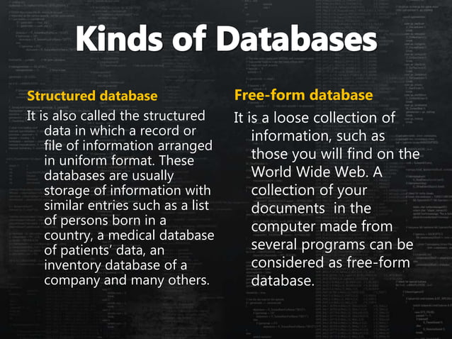

Slide 5
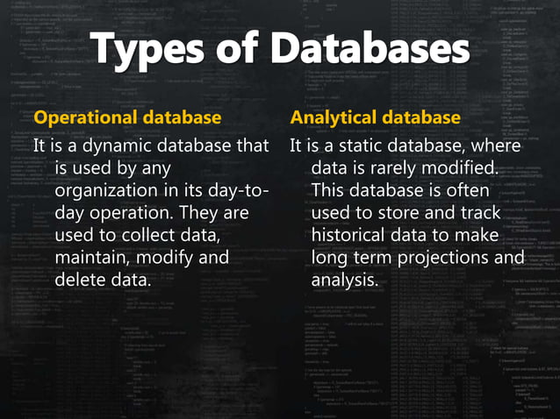
Notes:
Operational Database:
Purpose: Operational databases are designed for day-to-day transactional activities within an organization. They support the ongoing operations of an organization by efficiently managing and processing high volumes of transactional data in real-time.
Characteristics:
Fast and efficient data retrieval and modification.
Optimized for frequent read and write operations.
Typically normalized to minimize redundancy and ensure data integrity.
Example: A banking system's transactional database. Every time a customer makes a deposit, withdrawal, or transfer, the transaction is recorded in the operational database. The database ensures that the balance is updated accurately and in real-time, enabling customers to access their funds immediately.
Analytical Database:
Purpose: Analytical databases are optimized for complex queries and data analysis tasks. They are used to analyze historical data, identify trends, and gain insights into business performance.
Characteristics:
Optimized for read-heavy workloads involving complex queries and aggregations.
Often denormalized or structured in a star or snowflake schema to support efficient analysis.
Support for data warehousing and business intelligence tools.
Example: A retail company's data warehouse. The analytical database aggregates data from various operational sources, such as sales transactions, inventory levels, and customer interactions. Analysts can then query this database to generate reports on sales trends, identify popular products, and optimize inventory management strategies.
In summary, operational databases are geared towards supporting day-to-day transactional activities, ensuring fast and reliable data processing. On the other hand, analytical databases are designed to facilitate in-depth analysis and decision-making by providing a centralized repository of historical data and robust querying capabilities. Both types of databases play crucial roles in managing and leveraging data effectively within organizations.

Slide 6
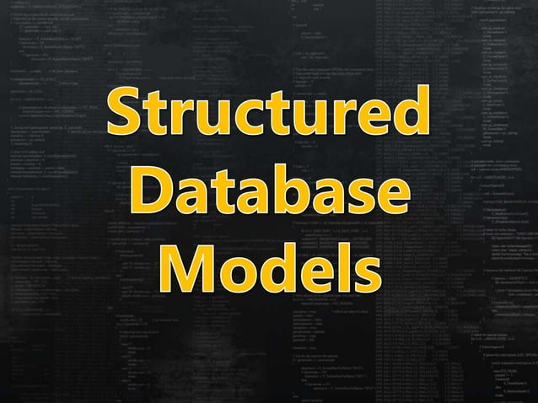

Slide 7
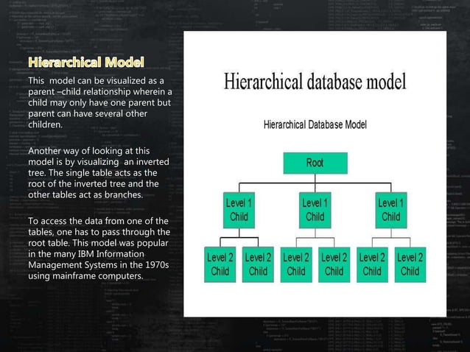
Notes:
A hierarchical data model is a way of organizing data in a tree-like structure, where each record has a single parent record and zero or more child records. In this model, data is organized in a top-down or inverted tree structure, with parent-child relationships defining the organization of the data.
Here's a simple explanation with an easy example:
Example: Consider a company's organizational chart. In this hierarchical data model:
Root: The CEO of the company serves as the root of the hierarchy.
Parent-Child Relationships: Each employee (except the CEO) reports to another employee, creating a parent-child relationship. For example, department managers are parents to their respective teams, and each team member is a child of their manager.
Tree Structure: The organizational chart forms a tree structure, where the CEO is at the top (root), followed by layers of management, departments, teams, and individual employees.
Hierarchical Data Model Characteristics:
One-to-Many Relationships: Each parent record can have multiple child records, but each child record can have only one parent.
Top-Down Structure: Data is organized in a top-down fashion, with a single root at the top and branches extending downward.
Fast Access: Retrieving data is efficient when navigating down the hierarchy, starting from the root and traversing through parent-child relationships.
Limited Flexibility: The hierarchical model is rigid and less flexible compared to other data models like the relational model.
Advantages:
Simple and intuitive structure, especially for representing parent-child relationships.
Efficient for representing data with a clear, predefined hierarchy.
Disadvantages:
Lack of flexibility, making it challenging to represent data with complex relationships.
Difficulty in handling many-to-many relationships, as they are not naturally supported in the hierarchical model.
In summary, a hierarchical data model organizes data in a tree-like structure with parent-child relationships, where each record has a single parent and zero or more children. It's commonly used for representing hierarchical data such as organizational structures, file systems, and XML documents.

Slide 8
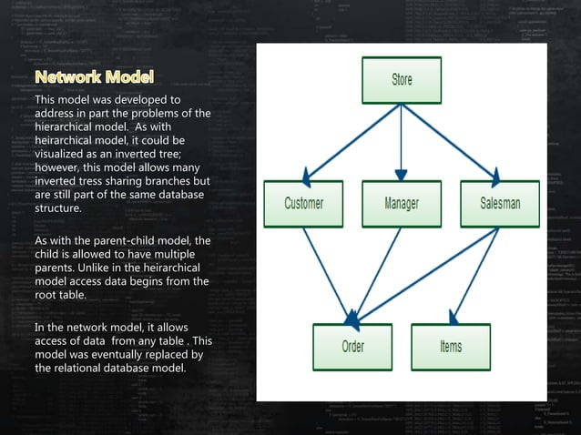
Notes:
The network database model is a way of organizing data in a network-like structure, where each record can have multiple parent and child records, creating a more flexible relationship structure compared to the hierarchical model. In this model, records are linked together through sets of pointers, forming a network of interconnected nodes.
Let's explain the network database model with an easy daily life example:
Example: Social Media Connections
Imagine you're using a social media platform where users can connect with each other. In this network database model:
Users as Nodes: Each user profile represents a node in the network.
Connections as Relationships: Friend connections between users create relationships in the network.
Multiple Connections: Unlike hierarchical models where each record has one parent, users in the network model can have multiple connections (friends), and they can also be connected to by multiple users.
Bidirectional Relationships: Relationships can be bidirectional. If User A is friends with User B, User B is also friends with User A.
Flexible Structure: The network model allows for a more flexible structure compared to the hierarchical model, as users can have multiple connections without a strict hierarchy.
Network Database Model Characteristics:
Many-to-Many Relationships: Records can have multiple parent and child records, enabling many-to-many relationships.
Pointers and Links: Records are linked through pointers or links, allowing for navigation between related records.
Complex Queries: While more flexible, complex queries may be required to navigate through the network structure compared to simpler hierarchical structures.
Efficiency in Retrieval: Retrieving related data can be efficient, as records are connected directly through pointers.
Advantages:
Flexible structure allows for complex relationships and many-to-many connections.
Efficient for representing interconnected data, such as social networks or complex organizational structures.
Disadvantages:
Complexity in managing and querying the data due to the interconnected nature of records.
Can be challenging to maintain and update, especially as the network grows larger.
In summary, the network database model organizes data in a network-like structure, where records are interconnected through relationships, enabling more flexible and complex data representations. Daily life examples, such as social media connections, illustrate how this model can be applied to represent relationships in a networked environment.

Slide 9
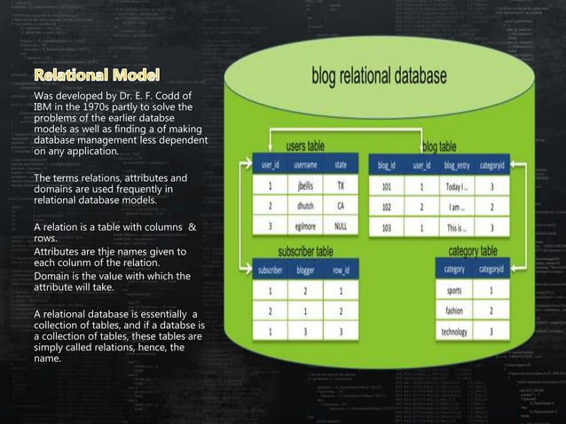
Notes:
Relational Database Model:
The relational database model organizes data into tables made up of rows and columns. Each table represents a specific type of data, and the relationships between tables are defined by common attributes or keys.
Example: Library System
Imagine you're building a library system to manage books, authors, and borrowers. Here's how the relational database model works in this context:
Tables:
You'll have separate tables for each type of data: books, authors, and borrowers.
Each table has rows (records) representing individual items and columns representing attributes (e.g., book title, author name, borrower ID).
Relationships:
The tables are connected through relationships based on shared attributes. For example:
The "Books" table might have an "AuthorID" column that links to the "Authors" table's "AuthorID" column, establishing a relationship between books and authors.
The "Books" table could also have a "BorrowerID" column linking to the "Borrowers" table, indicating which borrower has checked out a particular book.
Data Integrity:
Relational databases enforce data integrity through constraints like primary keys, which uniquely identify each record in a table, and foreign keys, which establish relationships between tables.
In our library example, each book might have a unique ISBN (International Standard Book Number) serving as the primary key, ensuring that each book is uniquely identified.
Querying Data:
You can retrieve and manipulate data using structured query language (SQL).
For instance, you could write a query to find all books by a particular author or to list all books checked out by a specific borrower.
Advantages:
Structured Data: Information is organized into well-defined tables, making it easy to understand and manage.
Flexible Queries: SQL allows you to retrieve and manipulate data in various ways, providing flexibility in data analysis.
Data Integrity: Constraints ensure that data remains consistent and accurate.
Disadvantages:
Complexity: Understanding and designing relational databases can be complex, especially for beginners.
Performance: Poorly optimized queries or large datasets can impact performance.
In summary, the relational database model organizes data into tables with defined relationships, enabling efficient storage, retrieval, and manipulation of information. The library system example demonstrates how this model can be applied to manage different types of data and their relationships effectively.

Slide 10
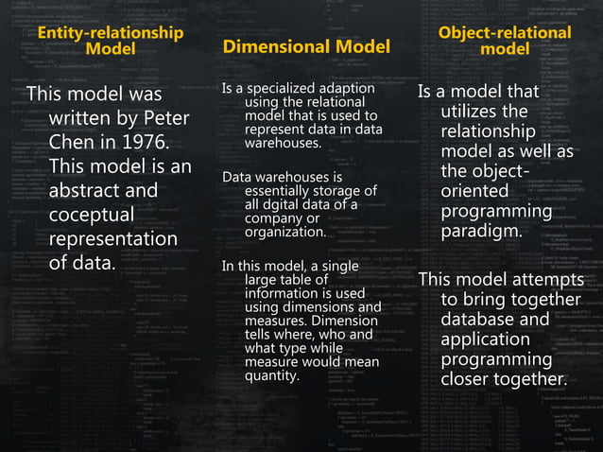
Notes:
The Entity-Relationship (ER) model is a way of representing real-world scenarios in a visual and structured format. It helps to design databases by identifying the entities (things of interest) and their relationships. Let's break it down with a simple example:
Entity-Relationship Model Explained with a Library Example:
Imagine you're designing a database for a library. Here's how the ER model works in this context:
Entities:
Book: An entity representing the books in the library. It might have attributes like Title, ISBN, and Publication Year.
Author: An entity representing authors. It might have attributes like Name, Birthdate, and Nationality.
Borrower: An entity representing the people borrowing books from the library. It might have attributes like Name, Address, and Member ID.
Relationships:
Book-Author Relationship: There is a relationship between books and authors because each book is typically written by one or more authors. This is a one-to-many relationship (one book can have multiple authors, but each author can write multiple books).
Book-Borrower Relationship: There is a relationship between books and borrowers because books are borrowed by library members. This is also a one-to-many relationship (one book can be borrowed by multiple borrowers, but each borrower can borrow multiple books).
Attributes:
Attributes describe the properties or characteristics of each entity. For example, the Book entity might have attributes like Title, ISBN, and Publication Year.
ER Diagram:
An ER diagram visually represents the entities, their attributes, and the relationships between them. It uses symbols like rectangles for entities, diamonds for relationships, and lines to connect them.
A dimensional model is a way of organizing data in a database that's specifically optimized for data analysis and reporting. It's designed to make it easy for users to query and analyze data, particularly for business intelligence (BI) purposes. Let's break it down in simple terms with an easy example:
Dimensional Model Explained with a Sales Data Example:
Imagine you're managing sales data for a retail store. Here's how the dimensional model works in this context:
Fact Table:
Think of the fact table as the centerpiece of your dimensional model. It contains quantitative data or "facts" about your business transactions or events.
In our sales example, the fact table might include data such as sales amount, quantity sold, and discounts applied.
Dimension Tables:
Dimension tables provide context to the data in the fact table. They contain descriptive attributes that help categorize and provide context to the facts.
For our sales example, dimension tables might include:
Product Dimension: Contains attributes like product name, category, and brand.
Time Dimension: Contains attributes like date, month, quarter, and year.
Store Dimension: Contains attributes like store name, location, and manager.
Customer Dimension: Contains attributes like customer name, age, and location.
Relationships:
Dimension tables are related to the fact table through keys. For example:
Each row in the fact table might have foreign keys linking to specific rows in the dimension tables.
These keys establish relationships between the fact table (containing sales data) and the dimension tables (providing context).
Object-Oriented Database Model Explained with a Zoo Example:
Imagine you're designing a database for a zoo. Here's how the object-oriented database model works in this context:
Objects:
In the object-oriented database model, data is represented as objects. Each object encapsulates both data (attributes) and behavior (methods).
For our zoo example, you might have objects representing animals, enclosures, and zookeepers.
Classes:
Classes define the structure and behavior of objects. They serve as blueprints for creating objects.
In our zoo example, you might have classes like Animal, Enclosure, and Zookeeper, each with its own attributes and methods.
For example, the Animal class might have attributes like species, age, and gender, along with methods like feed() and makeSound().
Inheritance:
Inheritance allows classes to inherit attributes and methods from other classes. It promotes code reuse and supports hierarchical relationships.
In our zoo example, you might have a subclass of Animal called Mammal, which inherits attributes and methods from the Animal class but adds specific characteristics of mammals.
Relationships:
Objects in an object-oriented database can have relationships with other objects, just like in OOP.
For our zoo example, you might have relationships like:
An animal object may be contained within an enclosure object.
A zookeeper object may have a caretaker relationship with multiple animal objects.
Advantages:
Modeling Flexibility: The object-oriented model closely mirrors real-world entities and relationships, making it intuitive to work with.
Code Reusability: Inheritance and encapsulation promote code reuse and maintainability.
Complex Relationships: Supports complex relationships between objects, facilitating more sophisticated data modeling.
Disadvantages:
Complexity: Implementing and managing an object-oriented database can be more complex than other models, especially for large-scale applications.
Performance: Object-oriented databases may not always offer optimal performance for certain types of queries and operations.
In summary, the object-oriented database model represents data as objects with attributes and methods, providing a flexible and intuitive way to organize and manage complex data structures. In our zoo example, it helps to model animals, enclosures, and zookeepers as objects with relationships and behaviors, facilitating efficient management of zoo operations.

Slide 11
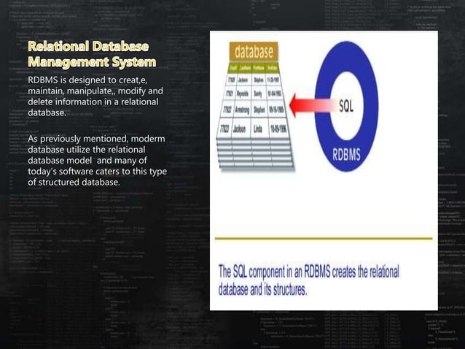

Slide 12
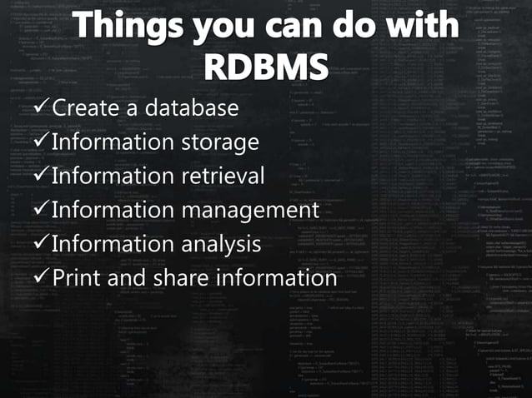

Slide 13
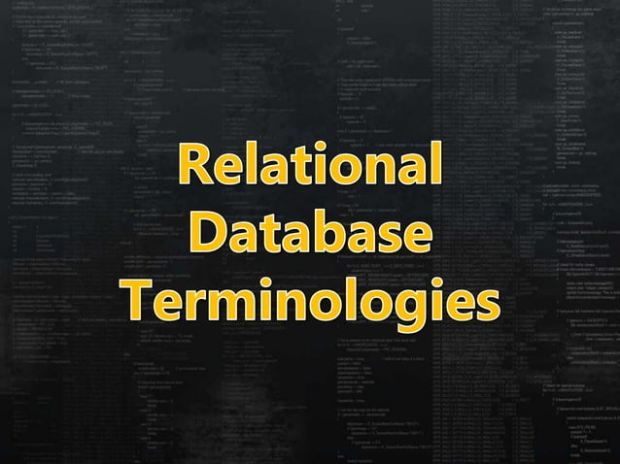

Slide 14
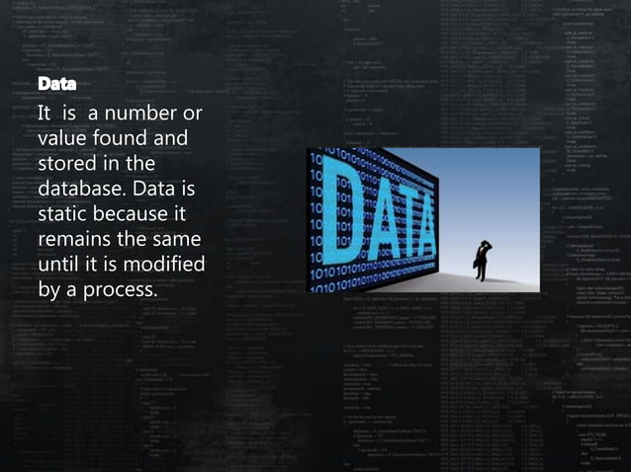

Slide 15
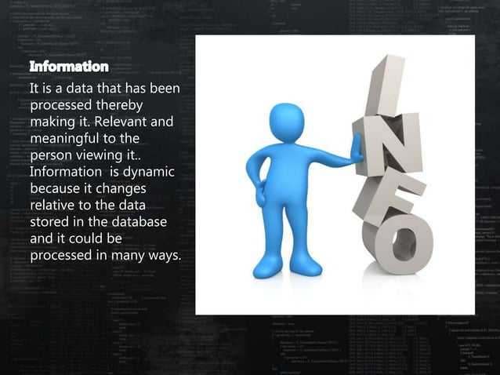

Slide 16


Slide 17


Slide 18


Slide 19


Slide 20
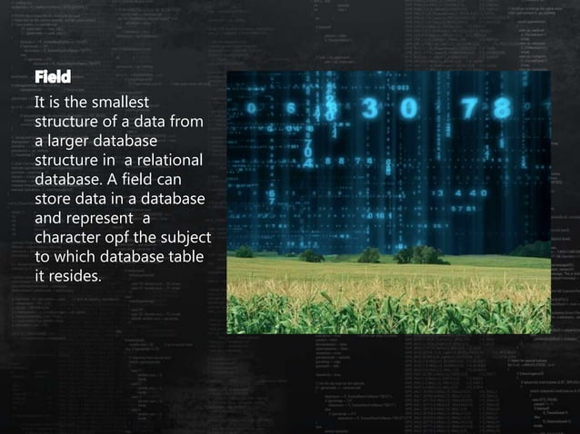

Slide 21
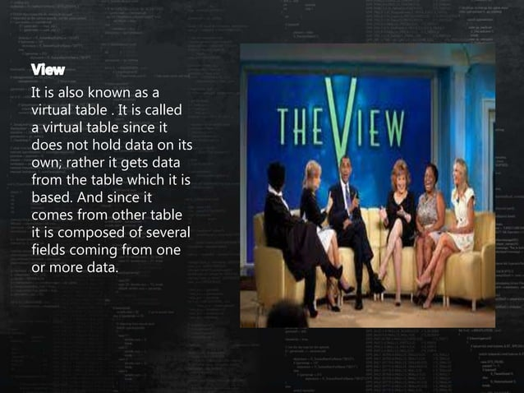

Slide 22


Slide 23


Slide 24
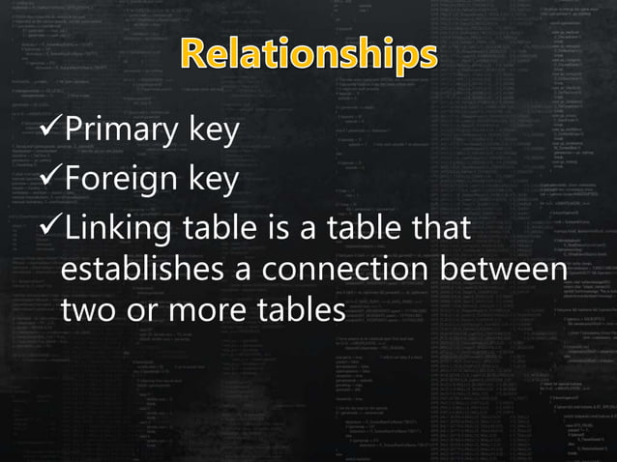

Slide 25
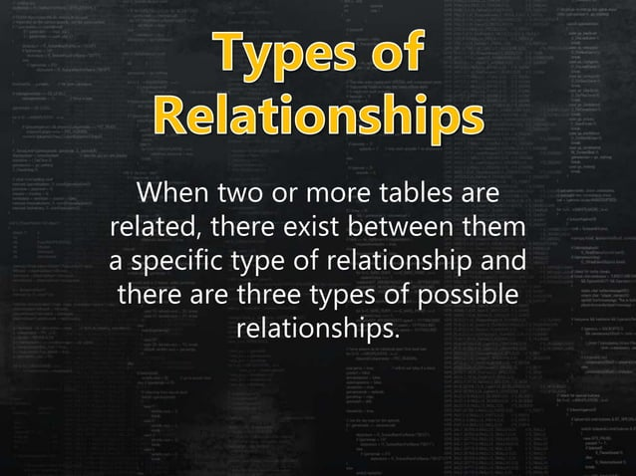

Slide 26
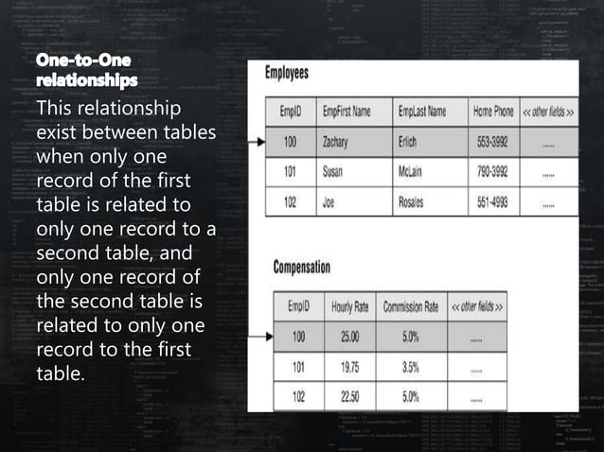
Notes:
A one-to-one relationship in a database refers to a relationship between two tables where each record in one table corresponds to exactly one record in the other table, and vice versa. This type of relationship is less common compared to one-to-many or many-to-many relationships but is still used in certain scenarios. Here's a real-life example to illustrate a one-to-one relationship:
Real-Life Example: Employee and Employee Details
Consider a scenario where you have two tables in a database: "Employee" and "EmployeeDetails." Each employee has a unique identifier (EmployeeID), and you want to store additional details about each employee in a separate table.
Employee Table:
This table contains basic information about each employee, such as their name, department, and job title.
Example columns: EmployeeID (Primary Key), FirstName, LastName, DepartmentID, JobTitle.
EmployeeDetails Table:
This table stores additional details about each employee, such as their contact information, date of birth, and address.
Example columns: EmployeeID (Foreign Key), DateOfBirth, ContactNumber, Address.
In this example, each record in the "Employee" table corresponds to exactly one record in the "EmployeeDetails" table, and vice versa. Each employee has a unique EmployeeID, which serves as the primary key in the "Employee" table and the foreign key in the "EmployeeDetails" table.
Explanation:
Each employee has a single set of additional details stored in the "EmployeeDetails" table. For example, John Smith's contact information, date of birth, and address are all stored in one record in the "EmployeeDetails" table, linked to his EmployeeID.
Similarly, each record in the "EmployeeDetails" table corresponds to exactly one employee in the "Employee" table. The EmployeeID foreign key in the "EmployeeDetails" table ensures that each set of additional details is linked to a specific employee.
Benefits:
Normalization: Storing additional details in a separate table helps maintain data integrity and reduces redundancy.
Flexibility: It allows you to add or modify additional details for each employee without affecting the structure of the "Employee" table.
Overall, the one-to-one relationship between the "Employee" and "EmployeeDetails" tables allows for efficient organization and management of employee data, ensuring that each employee's basic information and additional details are appropriately linked in the database.

Slide 27
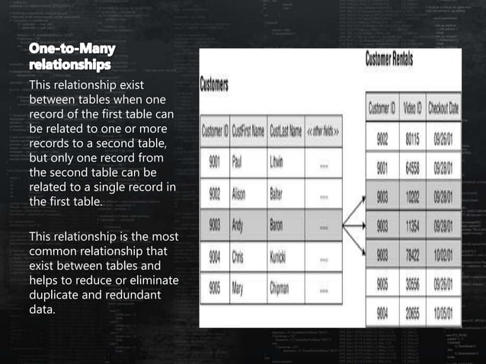
Notes:
A one-to-many relationship in a database refers to a relationship between two tables where one record in the first table can be associated with one or more records in the second table, but each record in the second table is associated with only one record in the first table. This type of relationship is quite common in database design. Let's illustrate it with a straightforward real-life example:
Real-Life Example: Parent and Children
Consider a scenario where you have two tables in a database: "Parent" and "Children." Each parent can have multiple children, but each child belongs to only one parent.
Parent Table:
This table contains information about parents, such as their names and contact details.
Example columns: ParentID (Primary Key), FirstName, LastName, Email.
Children Table:
This table stores information about children, including their names, dates of birth, and parent associations.
Example columns: ChildID (Primary Key), FirstName, LastName, DateOfBirth, ParentID (Foreign Key).
In this example:
Each record in the "Parent" table represents a unique parent, identified by the ParentID.
Each record in the "Children" table represents a unique child, identified by the ChildID. The ParentID column in the "Children" table establishes the one-to-many relationship.
Multiple children records in the "Children" table can have the same ParentID, indicating that they belong to the same parent.
Explanation:
For instance, if John and Mary are parents, they will each have a record in the "Parent" table with unique ParentIDs.
Their children, such as Sarah, Michael, and Emily, will each have records in the "Children" table. Each child record will include the corresponding ParentID to indicate who their parent is.
Since John and Mary can have multiple children, the same ParentID will appear in multiple rows in the "Children" table.
Benefits:
Data Organization: The one-to-many relationship allows you to efficiently organize and manage data about parents and their children in separate tables.
Data Integrity: By linking child records to parent records through foreign keys, you can maintain data integrity and ensure accurate relationships between parents and children.
Overall, the one-to-many relationship between the "Parent" and "Children" tables provides a structured approach to representing parent-child relationships in the database, reflecting the real-world scenario where one parent can have multiple children.

Slide 28
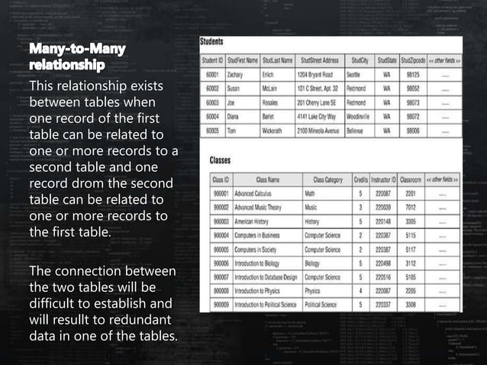
Notes:
A many-to-many relationship in a database occurs when multiple records in one table are associated with multiple records in another table. This type of relationship is quite common in real-world scenarios. Let's illustrate it with a simple example:
Real-Life Example: Students and Courses
Consider a scenario where you have two tables in a database: "Students" and "Courses." Each student can enroll in multiple courses, and each course can have multiple students.
Students Table:
This table contains information about students, such as their names and student IDs.
Example columns: StudentID (Primary Key), FirstName, LastName, GradeLevel.
Courses Table:
This table stores information about courses offered, such as course names and descriptions.
Example columns: CourseID (Primary Key), CourseName, Instructor, Schedule.
Enrollment Table (Join Table):
This table serves as a bridge between the "Students" and "Courses" tables to represent the many-to-many relationship.
It typically contains foreign keys referencing the primary keys of both the "Students" and "Courses" tables.
Example columns: StudentID (Foreign Key), CourseID (Foreign Key).
Explanation:
Each record in the "Students" table represents a unique student, identified by the StudentID.
Similarly, each record in the "Courses" table represents a unique course, identified by the CourseID.
The many-to-many relationship is represented by the "Enrollment" table, which contains pairs of StudentID and CourseID values.
For instance, if John and Sarah are students and they both enroll in a Math course, there will be a record in the "Enrollment" table with John's StudentID and the Math course's CourseID, as well as another record with Sarah's StudentID and the same Math course's CourseID.
Benefits:
Flexibility: Allows for flexible associations between students and courses, accommodating scenarios where multiple students can enroll in multiple courses.
Data Integrity: Maintains data integrity by separating the many-to-many relationship into a separate join table.
Real-Life Analogy:
Think of it like a library system where multiple students can borrow multiple books, and each book can be borrowed by multiple students. The "Students" table represents the students, the "Courses" table represents the books, and the "Enrollment" table represents the borrowing transactions, linking students to the courses they've enrolled in.
Overall, the many-to-many relationship between the "Students" and "Courses" tables, represented through the "Enrollment" table, allows for efficient management of student-course associations in the database, reflecting the real-world scenario where multiple students can enroll in multiple courses.

Slide 29
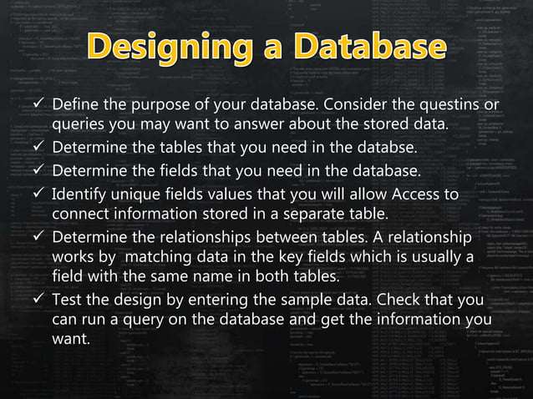

Slide 30
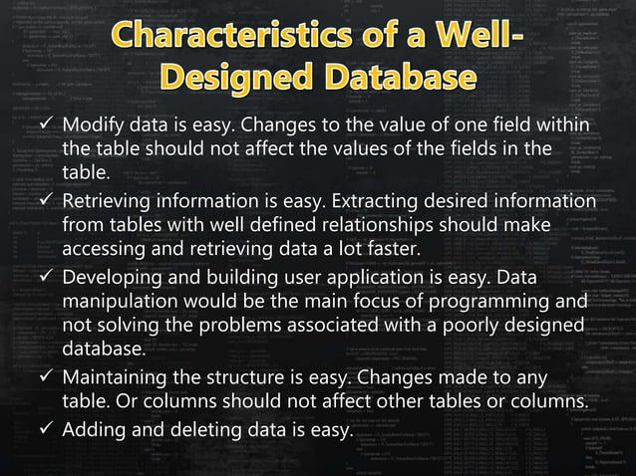

Slide 31


Slide 32


Slide 33


